Slide 1
FINANCIAL SALES
PERFORMANCE DASHBOARD
Excel Data Analysis Project
A portfolio project exploring sales, profit, discounts, products, countries, and business segments.
Tools: Microsoft Excel • Pivot Tables • Charts • Dashboard Reporting

Slide 2
Project Overview
A summary of the supplied Financial Sample workbook
TOTAL SALES
$118.7M
TOTAL PROFIT
$16.9M
GROSS SALES
$127.9M
TOTAL DISCOUNTS
$9.2M
Dataset and workbook
Project goals
• 700 transaction rows in the Financial data sheet
• 6 workbook sheets: Financial data, Dashboard, and PS1–PS4
• Sales period represented: 2013, 2014
• Key measures: sales, profit, gross sales, discounts, COGS, and units sold
• Compare sales across years and countries
• Identify leading products and customer segments
• Review discount levels alongside sales and profit
• Communicate results through concise visuals

Slide 3
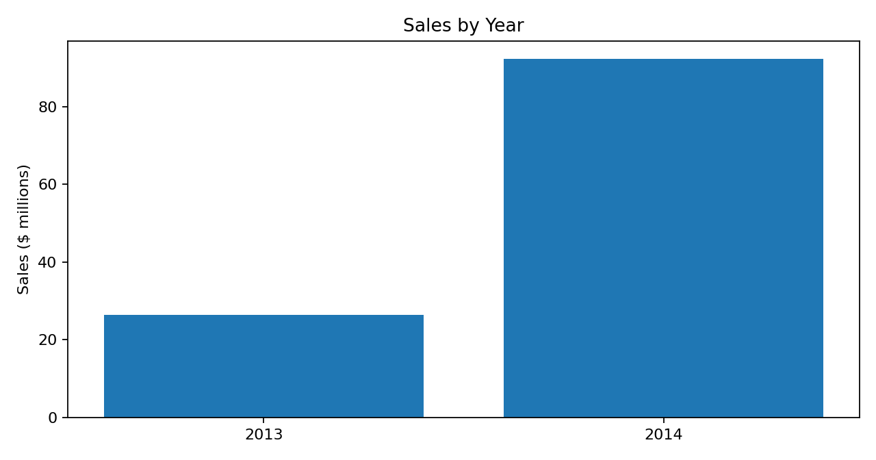
Sales Trend by Year
Sales increased substantially from 2013 to 2014 in the supplied data
Annual sales
2013: $26,415,256
2014: $92,311,095
2014 sales were approximately 249.5% higher than 2013.

Slide 4
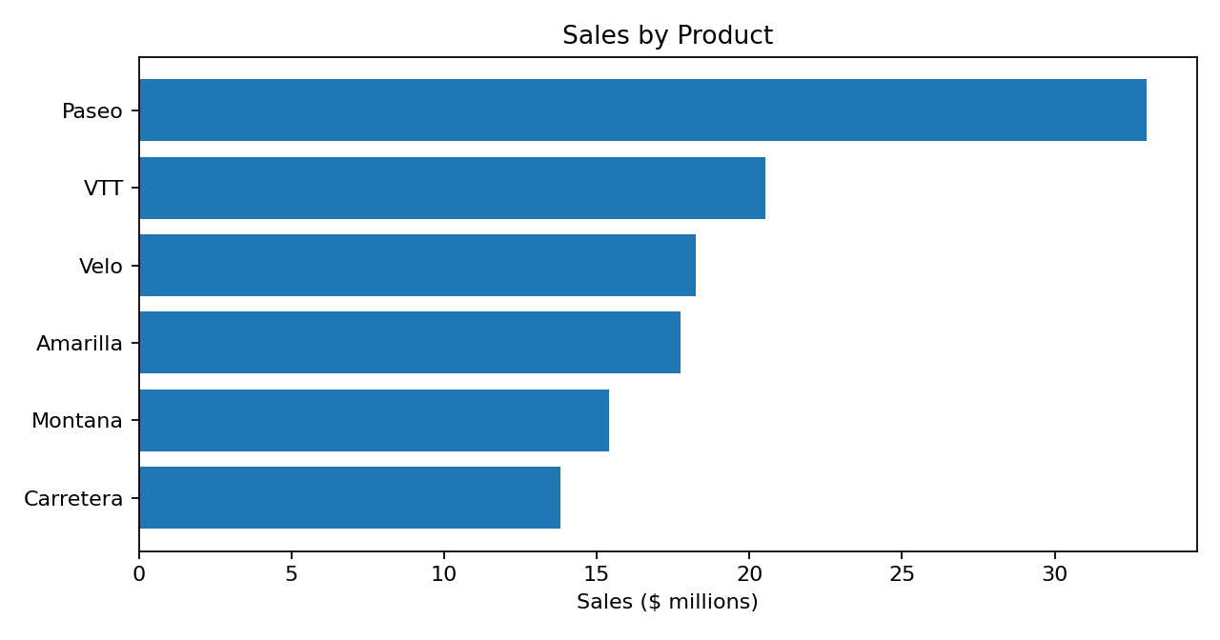
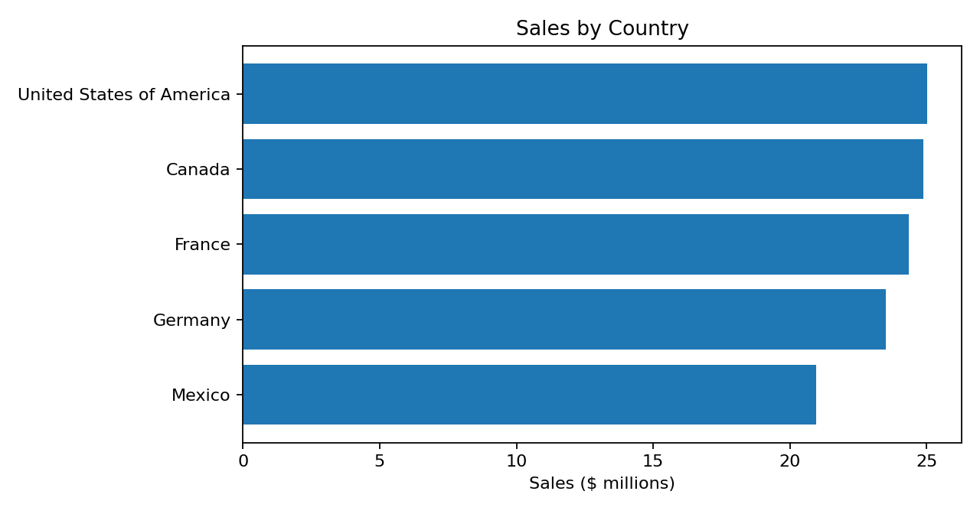
Product and Country Performance
Rankings are based on total sales in the workbook
Top product: Paseo ($33.0M)
Top country: United States of America ($25.0M)

Slide 5
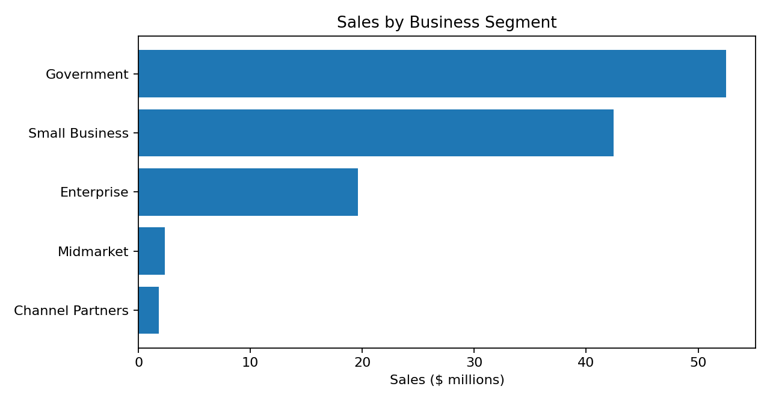
Sales by Business Segment
Government and Small Business account for the largest sales totals
Segment ranking
1. Government: $52.5M
2. Small Business: $42.4M
3. Enterprise: $19.6M
4. Midmarket: $2.4M
5. Channel Partners: $1.8M
Use this view to compare segment contribution and guide follow-up analysis of profitability, discounts, and customer needs.

Slide 6
Key Findings and Next Steps
Summary based on workbook totals; validate business context before decisions
Key findings
Recommended next steps
• Total sales: $118,726,350 across 700 transaction rows.
• Total profit: $16,893,702; overall profit margin is approximately 14.2%.
• Total discounts: $9,205,248 (about 7.2% of gross sales).
• Leading product by sales: Paseo; leading country: United States of America.
• Leading business segment by sales: Government.
• Add slicers for year, country, product, and segment.
• Compare profit margin—not only sales—across segments and products.
• Investigate negative-profit rows and high-discount transactions.
• Refresh the dashboard when the source data is updated.
• Publish the workbook and this presentation in a GitHub portfolio repository.
Prepared from Project Financial Sample.xlsx

